Slide 1
VIRTUAL MOUSE Using Hand Gestures
By C .Jeremy David

Slide 2
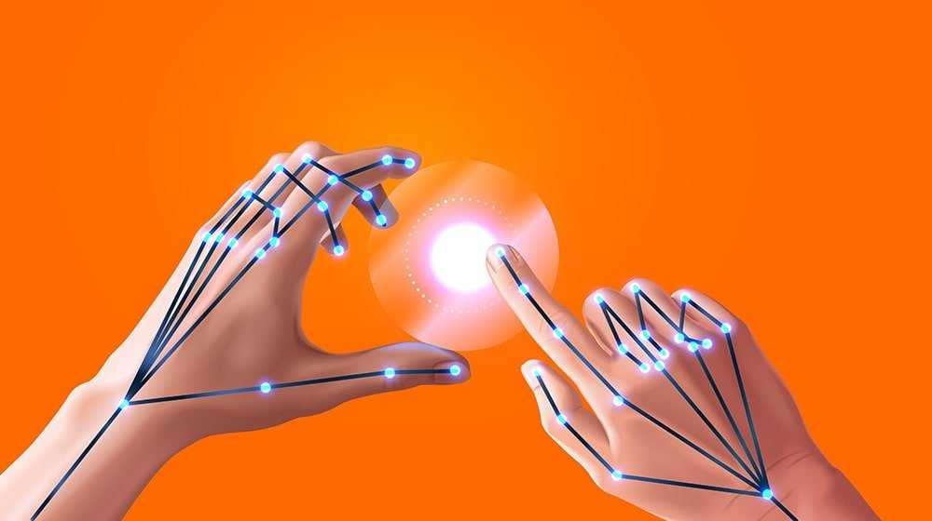
INTRODUCTION
There is no other more popular navigation device than mouse . Keeping this in mind, this project is an idea of implementing a Virtual Mouse system as an alternative .
The main objective of the proposed system is to perform computer mouse cursor functions and scroll function using a web camera or a built-in camera in the computer instead of using a traditional mouse device

Slide 3
PROBLEM STATEMENT
To Design a virtual mouse which detects hand gestures and performs mouse operations only using the fingers
In proposed system users don’t have to color their fingers with a specific color and are not required to use any device or sensors.
It is easy to use and cost effective.

Slide 4
EXISTING SYSTEM
Optical Mouse
Uses light-emitting diode and photodiodes to detect movement relative to the underlying surface. It uses Digital image correlation , an technology pioneered by defence industry
It’s Disadvantages is that it needs an hardware and specific surface requirements.

Slide 5
What is Virtual Mouse ?
. The Virtual Mouse provides an infrastructure between the user and the system using only a camera. It allows users to interface with machines without the use of mechanical or physical devices, and even control mouse functionalities
User makes specified hand gestures that is captured by the camera.
Object recognition techniques are used to extract information from the capture.
This is then translated to some meaningful event on the screen.

Slide 6
LITERATURE SURVEY
HCI Technology
Human-computer interaction (HCI) is an area of research and practice that emerged in the early 1980s.
Gesture Recognition
Gesture recognition is the mathematical interpretation of a human motion by a computing device using MEMS.

Slide 7
ALGORITHM USED
The AI virtual mouse system makes use of the transformational algorithm, and it converts the co-ordinates of fingertip from the webcam screen to the computer window full screen for controlling the mouse

Slide 8
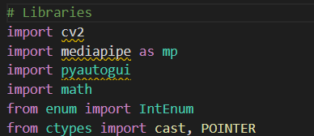
IMPLEMENTATION
Import Libraries:
Open CV (open source computer vision library)
Mediapipe
Numpy

Slide 9
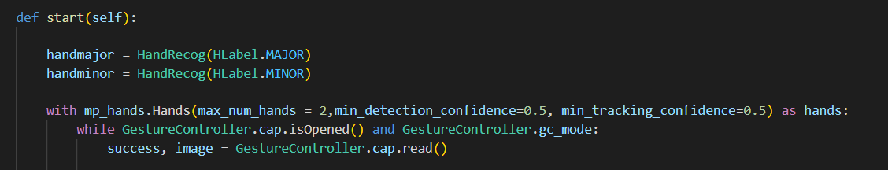
Hand Detection Module

Slide 10
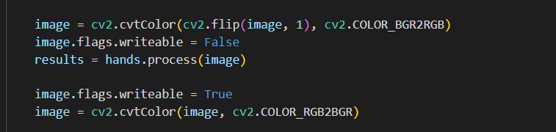
Converting BGR to RGB

Slide 11
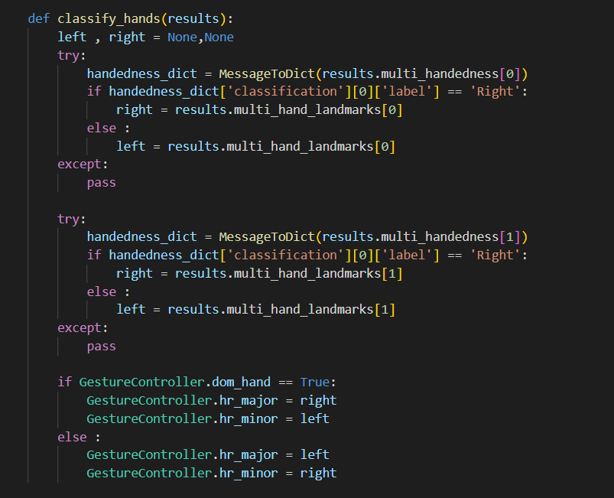
Classifying which hand is Raised

Slide 12
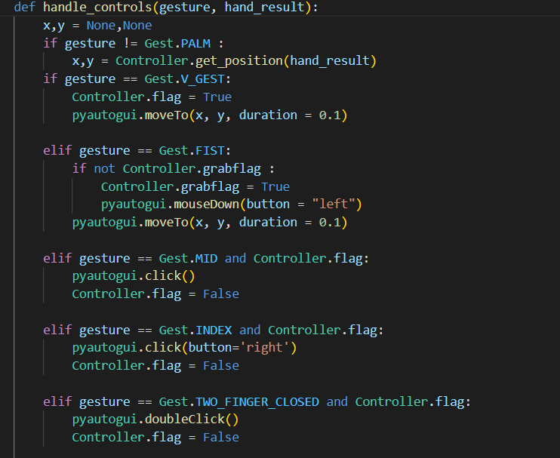
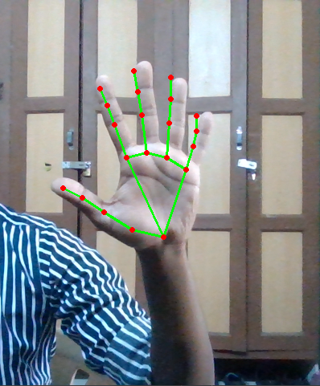
Detecting the Hand Gestures

Slide 13
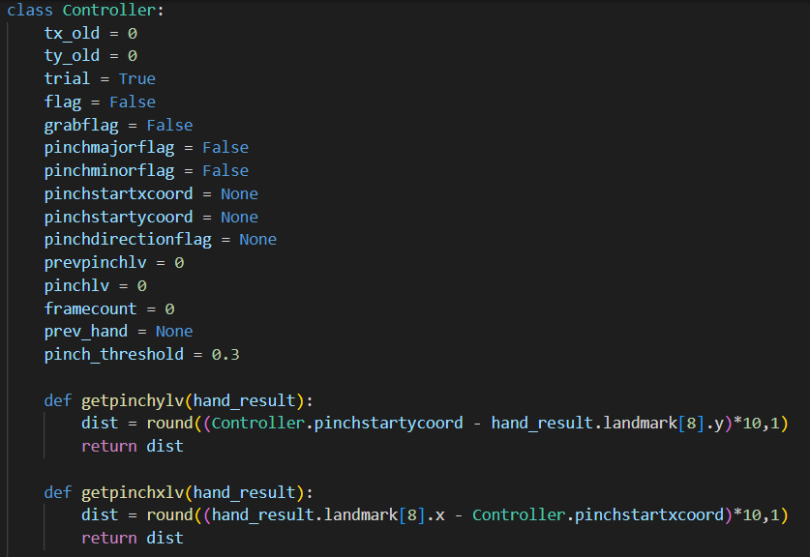
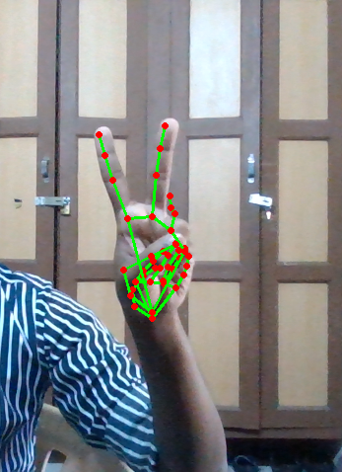
Actions for the corresponding hand gestures

Slide 14
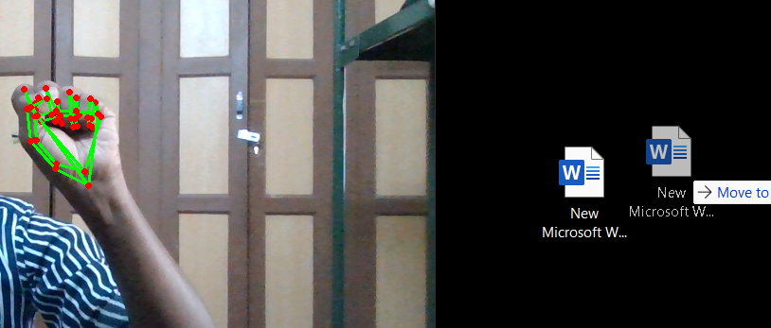
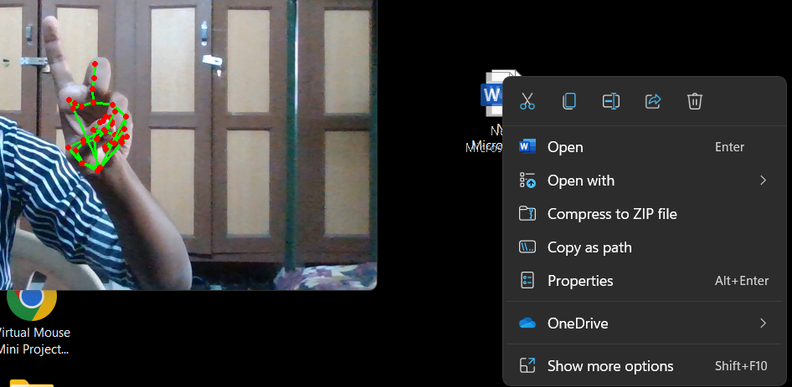
OTHER OPERATIONS
Drag & Drop
Right Click

Slide 15
APPLICATIONS
This application gives user an easy way to move mouse cursor on the screen.
Since user is using his hand, the homing time (time to place hand on the mouse) is reduced a lot.
The click is implemented with a very easy gesture.
With more robust finger tip detection, this application can replace the use of mouse.

Slide 16
LIMITATIONS
If background contains colors similar to skin, then the algorithm will loose track of the hand or falsely report its location.
Noise from sources such as segmentation error make it difficult to position the mouse pointer accurately
SOLUTIONS
The displacement of detected finger tip is averaged over few frames and this average displacement is used to displace the mouse cursor on the screen.

Slide 17
CONCLUSION
VIRTUAL MOUSE is an idea of implementing an adaptable, multi –functional navigation /interaction tool tht overcomes physical barriers.
However ,it is difficult to get stable results because oth the variety of lighting and skin colors of human races

Slide 18
THANK YOU !

